Slide 1
Communicate
With Purpose

Slide 2
Communicate With Purpose
As leaders we communicate every day. We convey information verbally, nonverbally, and through written word.
When we communicate with purpose, we can build relationships that lead to a unified and interconnected work environment.

Slide 3
Situational conversations
Controlling Emotions
email correspondence
Daily communications
conversation lanes
swaying the dialogue

Slide 4
We’ve All Been there

Slide 5
Clear Communication
Clear communication is a two-way process. When you are contacted by another person it is important to respond to every question or communication.
If someone asks you to perform a specific task, let them know the task was completed.
If another manager asks for assistance, respond to their request, even if you cannot help.
If an employee comes to you with an issue, communicate back to them how it is being resolved.

Slide 6
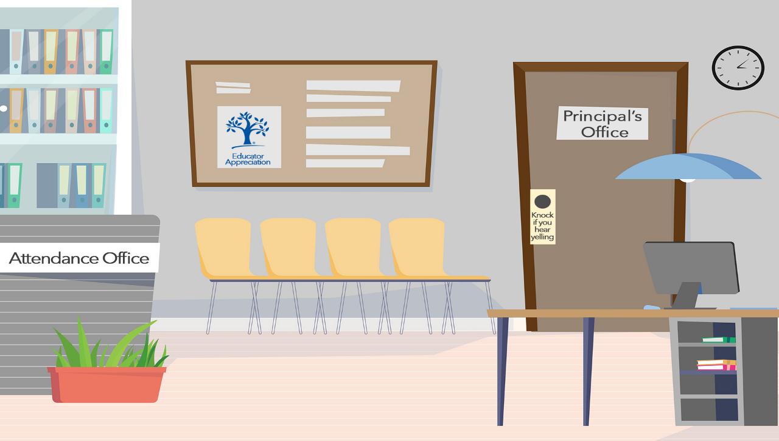
Hi Gretchen, some teachers requested copies of the field trip forms.
Sure, no problem. I will put them in their office box with instructions.

Slide 7
Collaborative Communication
During collaboration, communication takes place between staff members of the same or different job title.
This exchange of ideas creates:
Improved Productivity
Conflict Resolution
Shared Interests

Slide 8
Let’s review our work schedule. If you would like to try something new, let me know.
Notes:
NEXT SLIDE

Slide 9
Accurate Communication
Often you have immediate answers to questions as they are asked. However, there will be moments that you don’t have the answer.
It is okay to acknowledge that you need time to get the correct information.
“That’s a great question, let me get back to you.”
Give a timeline when you will provide the response
Follow up and provide the information requested
Thank the person for the opportunity to assist

Slide 10
8:26
8:27
8:28
8:29
8:30
8:31
8:32
8:33
8:34
1:25
8:25
You two make a great point. Let me see if we can make those adjustments and I will get back to you.

Slide 11
Editorial Eye Communication
There are times when information is given in a casual manner, however, decide if it’s best to use different words when relaying the message to others.
Self edit the information and consider how you and others would receive the message.
Be careful with oversharing
Know your audience
Identify if emotions are involved
Ask yourself: “does it really need to be said?”

Slide 12
I am so sorry the coffee is not to your liking.
You know you aren’t my ONLY customer!
Gretchen, this coffee is always too strong!

Slide 13
Emotions & Feelings

Slide 14
Emotions Versus Feelings
Emotions are our physical reactions to stimuli in the outside environment.
They activated through neurotransmitters and hormones released by the brain.
Feelings are the conscious experience of emotional reactions.
They are responses to thoughts and interpretations given to emotions based on experiences and personality.

Slide 15
Perception
When perceptions differ, then communication can break down.
Perception's effect on communication is how the same message can be interpreted differently.
People interpret things differently according to the way they were said
Body language is a silent communicator
Capitol letters in a written format can be perceived as shouting
“I HAVE TO GO”
Emotions are triggered and prepare us for behavior

Slide 16
email Communication

Slide 17
Emails Misinterpretations
All too often, it is difficult to have face-to-face or over the phone conversations due to scheduling conflicts and busy work, so we must resort to email communication.
Through text, the sender cannot accurately convey tone, emotion, facial expressions, gestures, body language, and eye contact; therefore, it is likely messages will be misinterpreted or misunderstood.

Slide 18
CREATIVITY
activity

Slide 19
Have you ever…?
…sent or received email that unintentionally caused anger or resentment?

Slide 20
Email Etiquette (Receiver)
Consider personality preferences
Acknowledge emails with a reply
Read emails carefully; do not misinterpret tone
Respond in timely manner
Remove contacts from side conversations to avoid “Reply Alls”
Be clear and concise
Consider a phone call for sensitive topics

Slide 21
Email Etiquette (Sender)
Consider personality preferences
Avoid negative words; always say “please” and “thank you”
Don't write anything you wouldn't want everyone to see.
Read and reread your email a few times, aloud, before sending.
Insert Receiver’s name last to avoid incomplete message
Watch your tone, can get lost in translation
Consider a phone call for sensitive topics

Slide 22
Daily Communication

Slide 23
Daily Conversations
There are different types of conversations that take place throughout the workday.
When talking with someone, it is helpful to know what type of conversation you need to have.
Positive Feedback
Show appreciation for a job well done.
Constructive Criticism
Provide guidance when a corrective action is required.
Disciplinary Issues
Address staff related issues.

Slide 24
Choose Right Time and Place
When preparing for a conversation, put as much thought into when and where it will take place as to what you are going to say.
Does it need to be addressed immediately or is it better to wait until later
Talk with the employee individually and privately
Ensure there are no distractions
Recognize that the conversation may be difficult

Slide 25
Inspire
Your everyday actions will influence staff. When you communicate positivity, it will reflect in the workplace culture of the cafeteria.
Visionary leaders inspire others with the verbal and nonverbal messages they communicate.
Engage with your staff consistently
Demonstrate teamwork
Communicate a shared vision with staff members
Allow your staff to share workplace concerns

Slide 26
You have a great idea. Let’s go with it!
Notes:
NEXT SLIDE

Slide 27
Be The Cheerleader
When a mistake is made, be the cheerleader and tell yourself, “I’m going to find a way to turn this bad moment into a good one.” Consider why the error happened in the first place.
Tune into what they have to say
Create solutions together
Appreciate staff for their efforts
Catch people doing things right

Slide 28
Opps, I forgot to change the temperature on the oven!
Mistakes happen, let’s be careful next time!
None of you ever do it right.
500
350

Slide 29
Life Is a pressure cooker

Slide 30
Why Would Someone Be Under Pressure?
DEADLINES
EMPLOYEES
UPSET CUSTOMER
LAST MINUTE CHANGES
SUPERVISOR
BILLS
KIDS

Slide 31
Grace Under Pressure
The term “Grace Under Pressure” refers to the behavior of a person who is under a lot of pressure.
Stay calm and mature in stressful or problematic situations. Retain a positive outward appearance and remain polite when dealing with people.
Keep your cool!

Slide 32
Conversation Paths

Slide 33
Stay On Track
When addressing an issue with an employee, know what you want to talk about and stay on point. Maintain control of the conversation.
Don’t deviate from your intended outcome.
Have an agenda with specific talking points
Know what your preferred outcome is
Allow and encourage feedback
Identify why the issue happened

Slide 34
Preparing The Agenda
Prepare for the conversation by focusing on the issue. When planning the agenda, consider what needs to be said to attain the intended result.
Acknowledge the employee for their successes
Identify what the employee needs to know
Prepare for emotions that may arise
Determine the intended plan going forward

Slide 35
Control the Direction
Turn difficult conversations into a positive interaction. Create a path toward meaningful communication.
Be mindful of the direction the conversation is going.
Talk openly and honestly to develop trust with the person
Keep your cool, even when what is said is upsetting
Listen intently and avoid interrupting
Watch for signs of frustration from both of you

Slide 36
Conversation Phrases
During the conversation be mindful of the phrases that can be used to keep the interaction flowing in a positive direction. Listen carefully to determine the appropriate phrase to use:
Based on the direction the conversation is heading, you can redirect using certain language, tone and other keywords.
Clarifying Phrase
Comforting Phrase
Redirecting Phrase

Slide 37
Clarifying Phrases
“So, I hear you saying__________ and that made you __________”
“What you’re saying is important, so I want to make sure I understand what you’re saying”
“Share with me what happened.”
“This is the first I'm hearing of this.”
“I’m not sure if this was your intention.”
“It seems like we’re not hearing each other.”

Slide 38
Comforting Phrases
“I see how this would have upset you…..”
“Let me see if I can help you by….”
“What would you like to see happen?”
“I’m here to help….”
“I Understand”
“It is understandable, I was new once too.”
“It is understandable that you may feel that way.”
"I’d really like to hear what you think about...“

Slide 39
Redirecting Phrases
“Would you mind…” (then ask them to do what you need)
“What would you need in order to be satisfied?”
“Is it possible that…”
(to get someone to consider a new perspective)
“I see how that could be a concern.”
“Do you want to take a break and talk about it later?”
“Let’s look at it in a different way.”

Slide 40
Conversations can range from difficult to pleasant. Determine the best phrases to keep the dialogue moving.

Slide 41
CREATIVITY
activity

Slide 42
An employee keeps making the same mistake repeatedly despite previous conversations.
How can we communicate with purpose?
“It seems like we’re not hearing each other.”
“Let’s look at it in a different way.”
“Let me see if I can help you by….”

Slide 43
How can you discuss the incident without causing the situation to escalate?
A heated exchange takes place between and Café employee and school staff member. Café employee accuses the staff member of making racial insults and wants the insulter disciplined and possibly transferred.
You meet with the staff member to clarify details and find that the Café employee made the first insult.

Slide 44
What phrases did you select that will help you discuss the incident?
“Is it possible that…”
(to get someone to consider a new perspective)
“So, I hear you saying__________ and that made you __________”
“I see how this would have upset you…..”
“What would you need in order to be satisfied?”
“I’m here to help….”

Slide 45
Swaying the dialogue

Slide 46
Sway The Dialogue
Turn difficult conversations into a positive interaction. Create a path toward meaningful communication.
Talk openly and honestly
Develop trust with the person you are communicating with
Listen intently and avoid interrupting
Keep your cool, even when what is said is upsetting
Watch for signs of frustration from both of you

Slide 47
Control Outcome of Conversation
When speaking with an administrator or parent, follow these tips to get to the root of the problem, deflate tensions and emotions in the conversation, while at the same time, providing a solution.
Switch Sides
Echo The Speaker
Stay on Agenda
Reinstate Their Needs
Explain Benefits of Outcome
End With Your Results

Slide 48
Thank you for taking the time to listen to my concerns.
I am glad we could come up with a solution that works for both of us.

Slide 49
Situational conversations
Controlling Emotions
email correspondence
Daily communications
conversation lanes
swaying the dialogue

